Slide 1
Flight Delays MCI 2019
Inbound and Outbound
Team Members: Luis Coca, Tim Raynor, Sir Thompson, Regina Neitzey

Slide 2
Motivation and Process
Analyzed flight data for 2019 to date to find trends and/or correlations among factors such as carrier delays, days of the week, and cancellations for better and informed decisions to travel to and from Kansas City.
Motivation: We were thinking of vacation and how nice it would be as we ruminated over our project.
Questions asked: Started big and pared it down.
It began with pricing, best day of week on flights, hotels, attractions, transportation, etc.
This was too much information to analyze with the time that we had, so we started asking questions based off our data source.

Slide 3
Summary
There were some obvious issues with delays for a couple of specific airlines.
Overall, the average delay time is within a few minutes for each day of the week, whether due to weather, carrier, security or any other purpose.

Slide 4
Cleaning data and exploration?
Explaining the process for cleaning data (Luis)
How we got the data (Tim)

Slide 5
Limitations
Terminal Down for an entire year
International

Slide 6
Which is the best carrier overall?

Slide 7
Which is the best day of the week?
We looked at the best day of the week to avoid delays by using the average delay time in minutes overall and for each airline.
First, let’s take a look at the overall data for outgoing and incoming delays on each day of the week.
Notice there doesn’t seem to be much of a correlation between traffic and delays. But, it is useful to know which day of the week averages the least amount of flights and also has the lowest average delays.

Slide 8
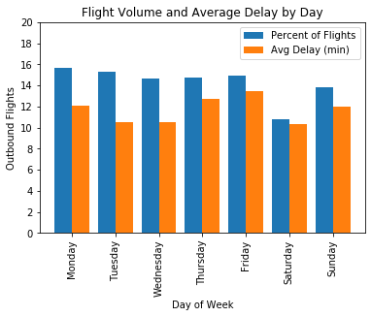
Saturday has the lowest number of outbound flights and has the best time on delays.

Slide 9
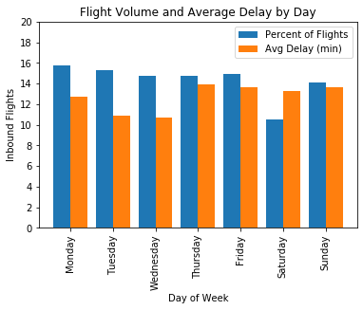
Saturday also has the lowest number of flights coming in, but Tuesday and Wednesday have the best time on delays.

Slide 10
Next, lets take a look at delays by day of the week for incoming and outgoing flights by airline.
Friday seems to be the peak day for delays overall on outbound flights except for Allegiant that peaks pretty high on Saturdays.
Allegiant and Frontier are the most inconsistent from day to day. It’s probably best to avoid either of them if it’s not the middle of the week for outbound.

Slide 11
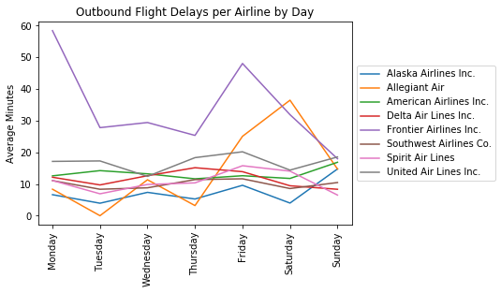

Slide 12
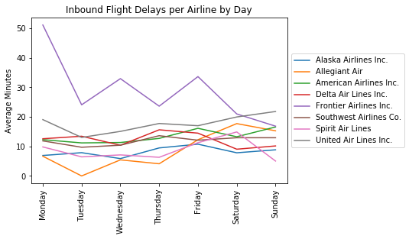

Slide 13
Weather Delay Data?

Slide 14
Cancellations Information.

